Slide 1
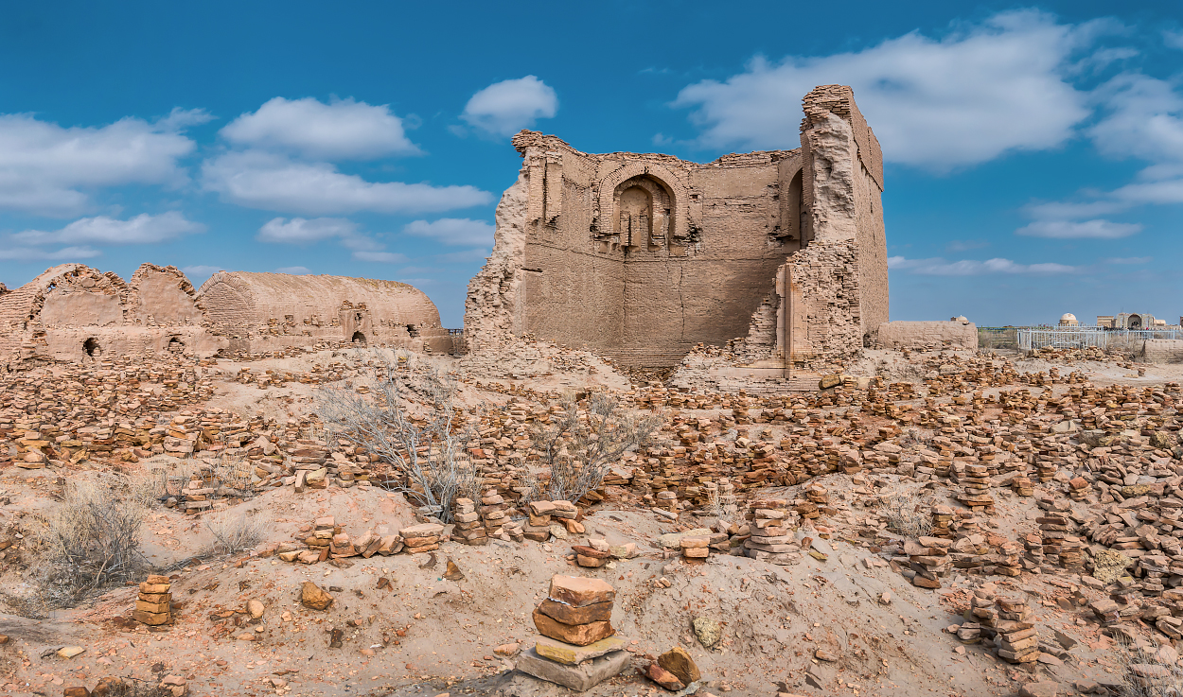


Full itinerary and detailed information about the trip.
Tour of Nukus
and the Mizdakhkan Necropolis
BEST COICE
BEST PRICES
RELIABLE TEAM

Slide 2

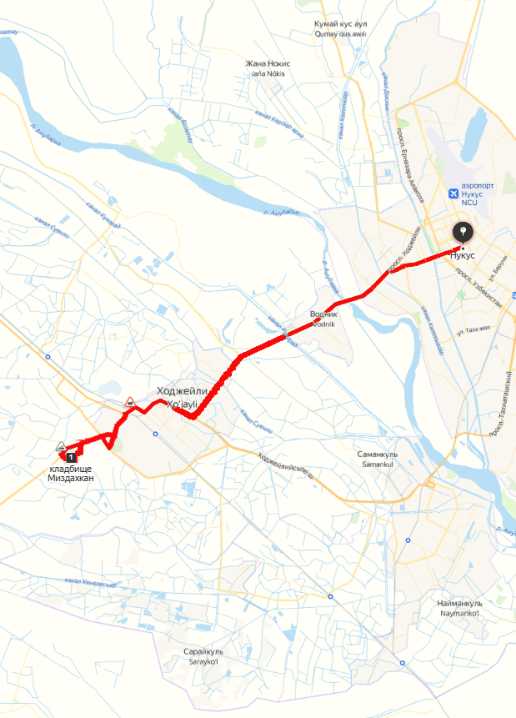

Trip itinerary
Duration:
1 day
Tour season:
Year-round
Total distance:
More than 330 km
Meals:
on request
Transport:
Sedan / Minibus

Slide 3

Day 1: Nukus - Mizdakhan Complex - Nukus
Start point:
Nukus city(Railway Station, Airport, Hotel, etc.)
9:00 - 11:30 Let's start the day with a visit to the I.V.Savitsky Karakalpak State Museum of Art, which is a phenomenal Louvre in the desert and a place of pilgrimage for art historians. The museum has about 100,000 exhibits in the collection of which there is the art of ancient Khorezm, the folk applied art of the Karakalpaks, as well as the Avant-garde forgotten under the layer of several decades. Here you will discover not only the work of great masters, but also fundamentally new views on the history of Russian and Soviet art in a global context.
11:30-13:00 We continue our journey to the State Museum of History and Culture of the Republic of Karakalpakstan. Here we will plunge into the atmosphere of history, exploring the wealth of archaeological, ethnographic and historical artifacts that will tell us the amazing stories of this region.
13:00-14:00 During a delicious lunch, discussing impressions and preparing for a new stage.
14:30-16:30 Visit to the Mizdakhkan archaeological complex, which is a Necropolis - it is a real treasure of history, representing a unique combination of ancient and medieval periods. The pride of the complex is a unique underground palace (XII-XIV) Mazlumkhan-sulu mausoleum, Khalifa-Yerezhep (IX-XI) and Mazar Shamun-nabi (XII century), Zhomart Kassap hill (VII-XII), as well as Gaur kala (VII-III centuries BC) are silent witnesses of the centuries-old stories.
16:30 – 17:00 Return to Nukus with exciting experiences and a huge amount of information.
Completion of the program.

Slide 4
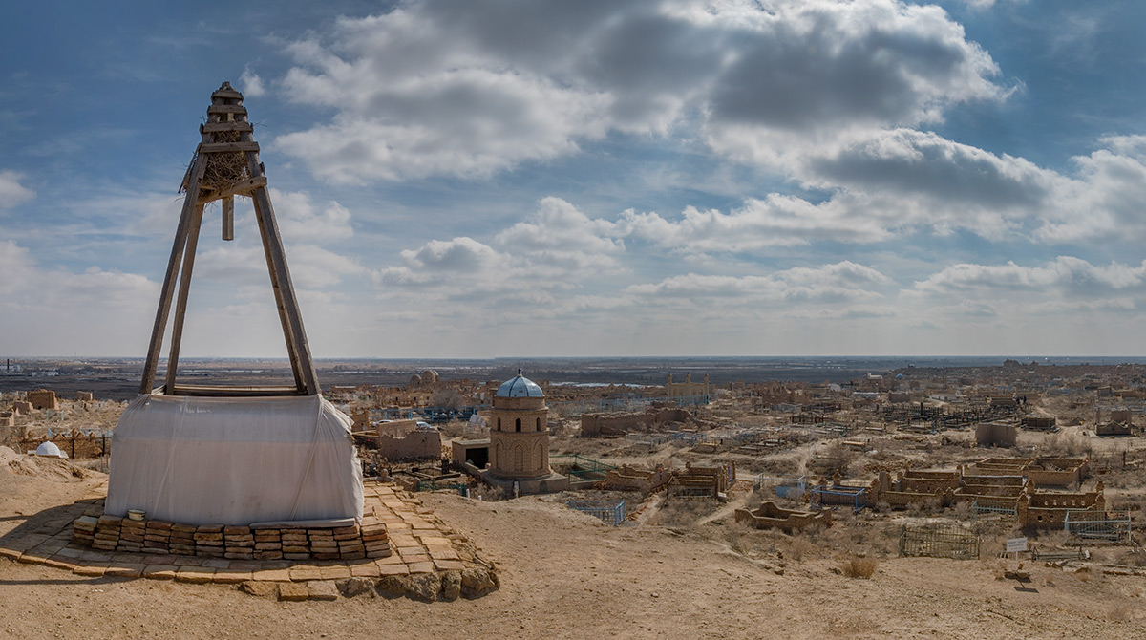
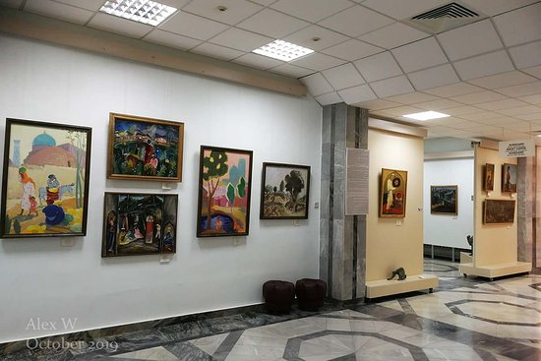
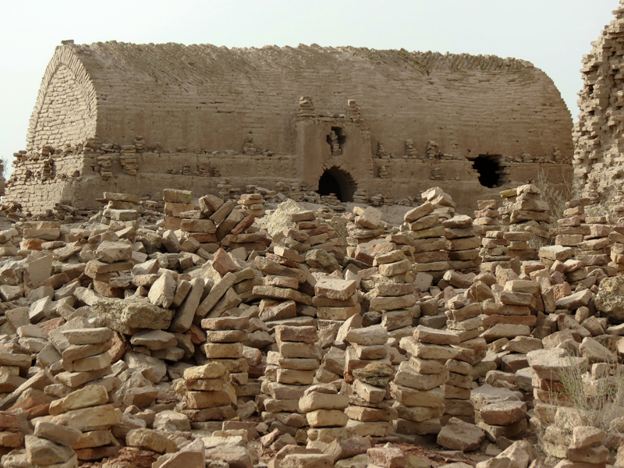
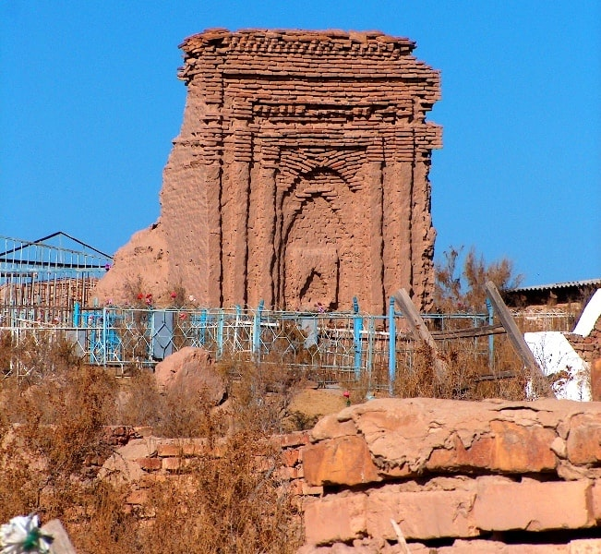

Slide 5
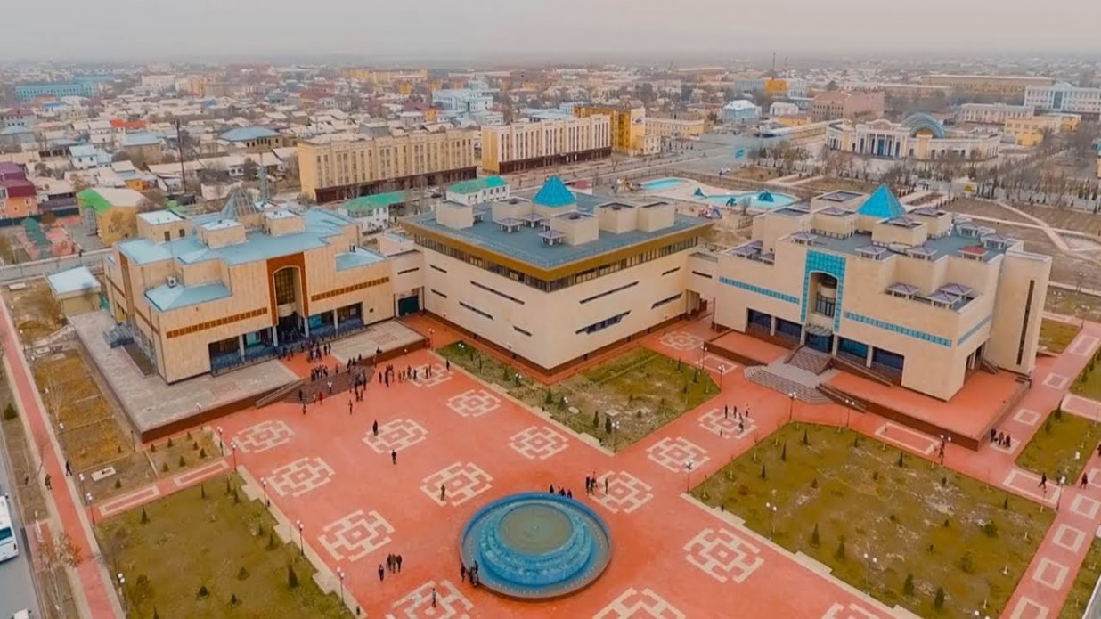
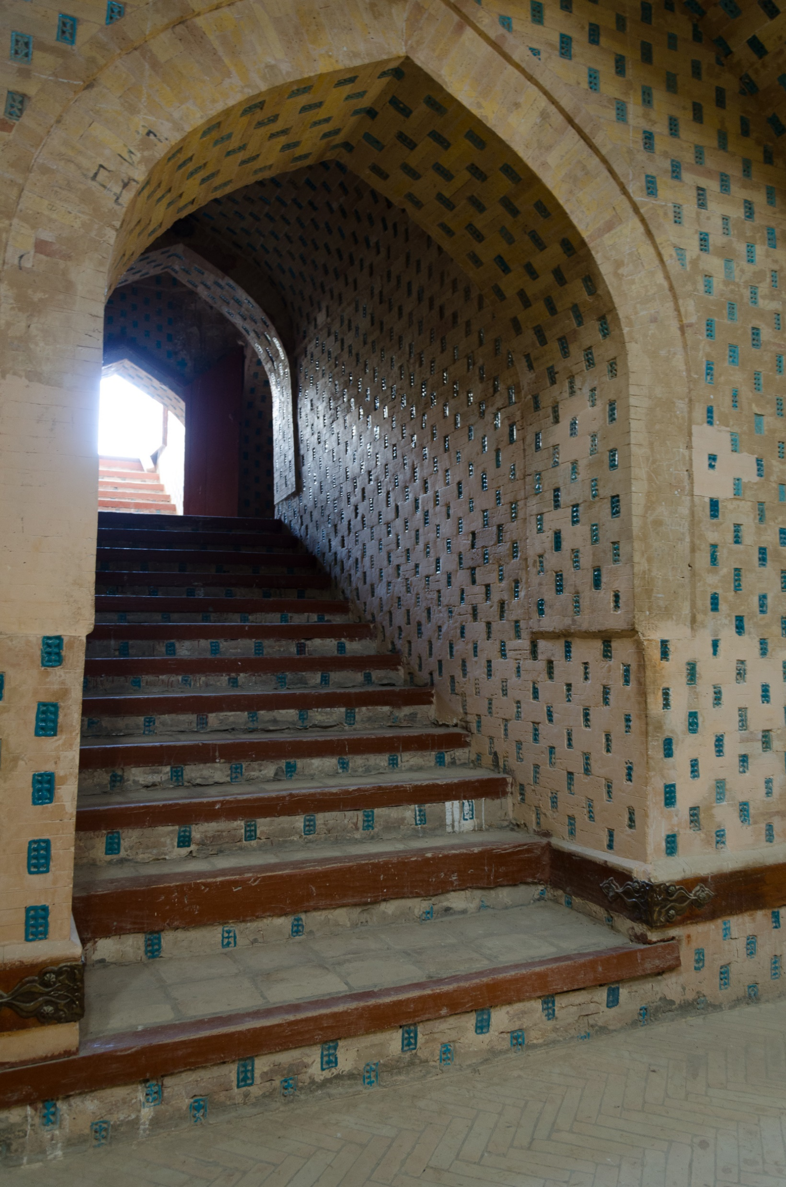
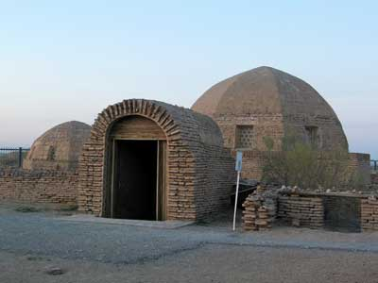
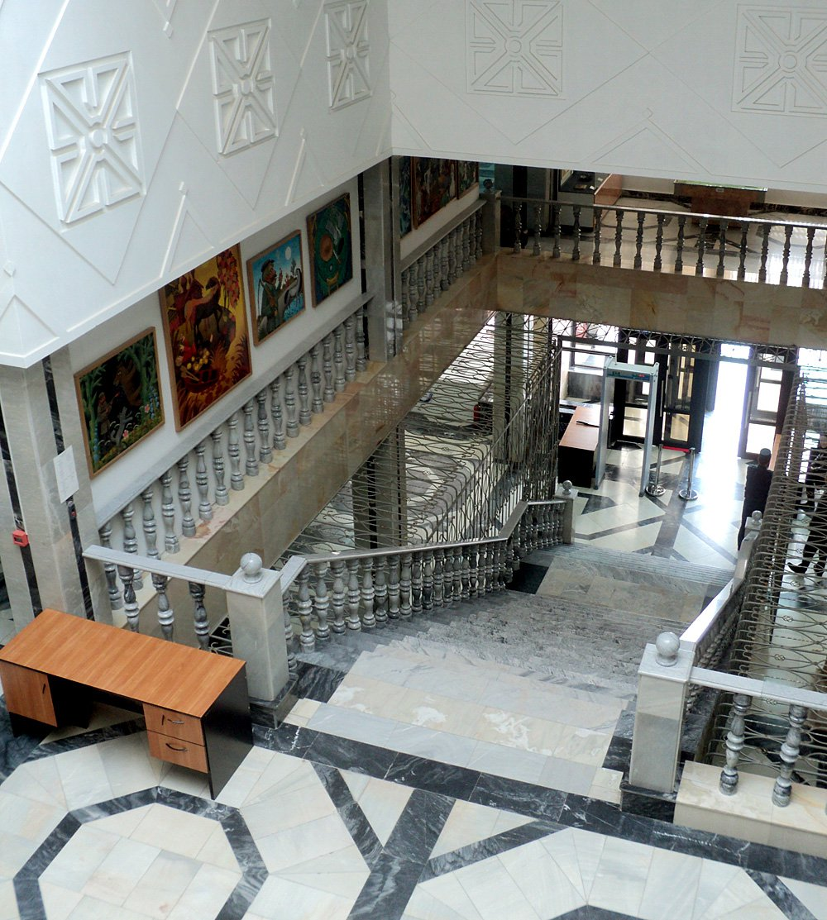
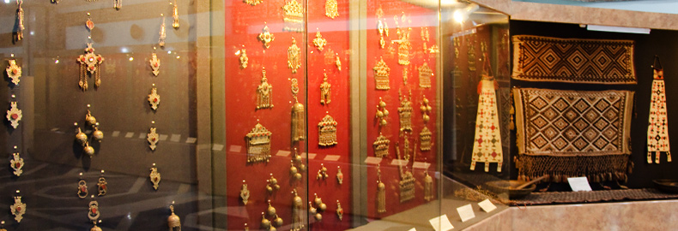

Slide 6
